Slide 1
Bank Security
DevSecOps: More than just Shift-left Security
Vince King
January 2023
Notes:
Shift-left Security: More than just a catchphrase
Vulnerabilities like Log4j may be headline grabbers, but thousands of applications are being targeted by hackers who use flaws in code as attack vectors. Vulnerabilities such as cross-site scripting or improper authorisation are on the increase, and with the increased use of open source software we need to ensure "shift-left security" is more than just a catchphrase.
During this presentation we'll look at:
- what modern development looks like
- what developers want
- what developers actually need
- where does security fit into to all this "agile" working?

Slide 2






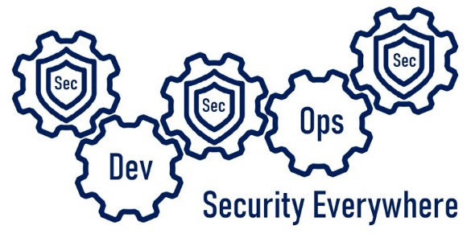

Who’s this talking to me now?
Vincent King
Senior Cyber Analyst
Head of DevSecOps
Bank of England
Reformed Developer
Secure Coding Subject Matter Expert
(ISC)² Certified Information Security Professional
Chartered Fellow of the BCS
DevSecOpsVince
Notes:
My name is Vince King, and I’ve been at the Bank of England for almost 10 years. I’m a reformed developer, and have numerous roles including Ops Lead and DevOps subject matter expert having created the DevOps capability within the Bank. I moved to Cyber 4 years ago working on Vulnerability Management and have been picking up as much experience (and as many certifications) as I can.
With my experience in DevOps and Cyber Security, I’m happy to lead the effort for DevSecOps within the Bank.
Now a word on what this presentation is, and more importantly, what this presentation is not. This presentation is an overview of what DeSecOps is; Why is it important; Why it isn’t just “shift-left”; and Where to start.
This presentation is not a discussion about specific tooling or vendors. It is not a indepth course of best practice. Most importantly, it is not the silver bullet that will immediately implement DevSecOps for you!

Slide 3



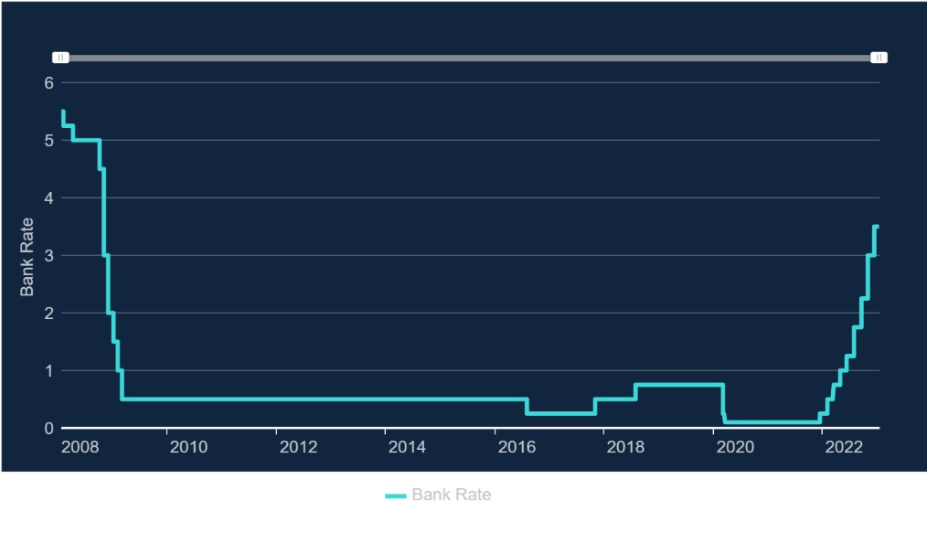


What does the Bank of England do?
Real-Time Gross Settlement
Settled an average of over £720 billion each working day
CHAPS | CREST | BACS | Image Clearing System for cheques | Faster Payments
LINK | Mastercard Europe | Visa Europe | PEXA
RTGS
Notes:
How we’re funded
Public facing
Although we are a public body, we do not get a budget from the UK Treasury. Instead, we generate the funds we need for our work by:
investing the money banks have to hold with us (this is called the 'Cash Ratio Deposit scheme')
charging the firms we regulate a fee
providing banking services to our customers, who include overseas central banks
charging for the cost of producing banknotes
charging a management fee for services we provide to government agencies
investing the capital we have built up over 300 years
The magic behind the curtains
The payments landscape continues to change at a rapid pace, reflecting changes in the needs of households and companies, changes in technology, and an evolving regulatory landscape. The Bank has operated the Real-Time Gross Settlement (RTGS) system since its introduction in 1996. RTGS lies at the heart of every payment in the UK and on average settles over £720 billion on an average day; broadly equivalent to the UK’s GDP every three days. RTGS settled £1 Trillion on its peak value day (30 September 2022) in the period. Banks and other financial institutions use accounts in RTGS to settle money owed to each other through the UK’s payment systems. The successful management and operation of RTGS directly supports the Bank’s mission to promote the good of the people of the United Kingdom by maintaining monetary and financial stability. As well as providing settlement services, RTGS is also the mechanism through which the Bank implements monetary policy decisions and provides liquidity to the UK’s financial system
Last year, RTGS settled an average of over £720 billion each working day; broadly equivalent to the UK’s GDP every three days. RTGS settled £1 Trillion on its peak value day (30 September 2022) in that period. The vast majority of the value settled (99%) is from CHAPS and CREST.
Now and looking into the Future
Due to the level of security around our services and the Bank’s risk-adverse attitude we became very comfortable building and running everything on premise. Our cloud adoption was also stunted by the attitudes of some executives within Technology, but the Bank is now committed to moving 80% of our services to the Cloud by 2030. So moving securely at speed is imperative.

Slide 4

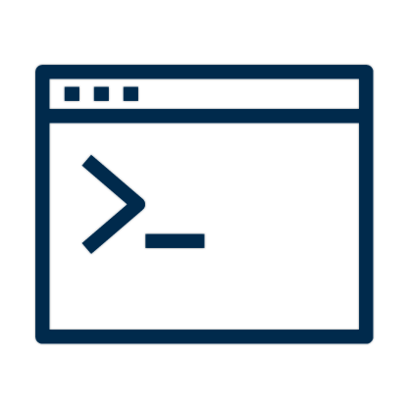


DevOps vs Security – The Perception
Dev
Dev
Sec
Ops
Notes:
Hopefully we all know what good DevOps looks like. Or at least we have read what it is supposed to look like.
Small teams working independently to implement their features, validating correctness in pre-production environments, with deployments into production happening predictably, quickly, safely, and securely, throughout the business day.
But why is reality not like the books? Having worked across multiple roles, I have some strong feelings about this!
As a developer I saw Cyber Security as a blocker to my freedom. It was stopping me using all the tools and code-snippets I found on the internet. I would avoid Cyber people because they were the department of “no”.
As a DevOps lead I saw Cyber as an impediment to innovation. Why couldn’t I have admin rights on every machine within the enterprise so I can run unsigned PowerShell scripts to performed deployments?
As an Ops lead I saw Cyber as the reason my new features were taking so long to reach production.
Finally, as a Cyber Analyst I saw that I was an idiot…. But in my defence, it wasn’t all my fault. Throughout the Technology department Cyber Security and their policies were perceived as obstacles to be worked-around. Their lack of open engagement supported their clandestine reputation.

Slide 5

Where should Sec live?
Sec
Sec
Sec
Ops
Dev
Security Everywhere
Notes:
So, how do we fix it, and where should Security live in the SDLC? Well … everywhere.
Work must be done to create a culture of collaboration between development, operations, and security with engagement being established as the earliest stages of a project or change, and running throughout the lifecycle.
Too often Security, like testing, is an afterthought. Problems are found too late to be corrected in time, and the system moves forward, running at risk. Here starts the technical debt spiral. Promises of, “we’ll fix this later” are rarely delivered due to other pressures.
Add in Cloud to this situation and part of this debt could lead to a major compromise or data breach.
As part of the culture change required to fully adopt DevSecOps, Security must work closely with Development and Operations, and most importantly, be an enabler.

Slide 6







Scary Slide No.1
Sec
Sec
Sec
Ops
Dev
Security Everywhere
Notes:
Firstly … I’m going to assume that everyone listening to me is aware of, and uses source control. Even if it is Visual Source Safe!?!?
In August 2019, GitHub was called out in a US lawsuit following the Capital One breach. The reason? Allowing social security numbers to be stored in a Git repository.
In October 2019, one misstep from developers at Starbucks left exposed an API key that could be used by an attacker to access internal systems and manipulate the list of authorized users. Lucky the vulnerability was reported as part of a bug bounty program and quickly resolved.
In January 2021, a misconfigured Git server at Nissan North America lead to the leak of the source code of the company's mobile apps and internal tools. A Git server was left publicly exposed with a default username and password of admin/admin.
More recently, in December 2022, Okta reported a breach that included the unauthorised downloading of source code. Access was possible through the use of stolen authorisation keys and could have been related to an extension phishing campaign in September of last year.
While still reading and digesting the information around the Okta breach, a few days later we got news of an attack on Slack. The incident involves threat actors gaining access to Slack's externally hosted GitHub repositories via a "limited" number of Slack employee tokens that were stolen.
Can anyone see the connection between all of these incidents … other than they involved source control?
They all involved human error. Tools can give us the ability to be secure, but they can’t guarantee it … they cannot protect us against ourselves.

Slide 7
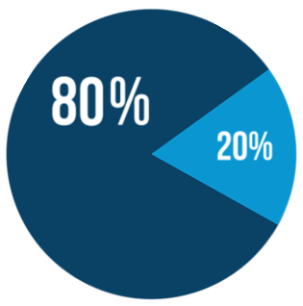
Where should Sec live?
Sec
Sec
Sec
Ops
Dev
Security Everywhere
Secure coding training
Code reviews
SAST
Secure code reuse
Strict policies
Secure code champions
Peer oversight
High trust team
Open Source code use
Newer container images
Notes:
In real terms, developers within an organisation fall within the “80/20” divide. Any organisation that is more than 1 year old has technical debt, and an ever growing code base. The 80% typically work on legacy systems fixing bugs and adding features to an already established application.
The other 20% are, typically, more senior or proactive devs who want to use all the cool new tools and resources. They will seek out new processes and work with the latest, possibly less established, components, but are highly trusted.
Security must support these groups in different ways. The 80s need the capability to produce security code, have processes to support peer review, understand the resources available in the Cloud, and have a clearly defined toolset to develop and test what they write. SAST and DAST tools, when combined with a clear feedback loop helps re-enforce positive behaviour.
Re-use, especially of open source components, is at the centre of a modern and efficient development team, but it also has the ability to introduce security issues. The log4j vulnerability is still fresh in our minds. Again, Security must be an enabler and support the use of open source components, but this must be done is a controlled manner. The culture must move away from developers just jumping onto the internet and grabbing libraries and instead have access to a curated collection of components.
Things for the 20% can be “slightly” less restricted and should be allowed to innovate by trying new things. Being part of a “high trust, virtual, team” they should have a deeper understanding of security concerns but be enabled to test-drive new tooling and components. Although the trust level is much higher, they should still play within a walled garden. By creating this safe space for innovation and creating a process for new, approved, ways of working to be made available with the 80s, technical improvement can be seen across all teams.
A virtual community of Secure Code Champions, made up of this highly trusted 20%, can be leveraged to support 80% development teams. This serves a number of purposes; it gives an opportunity for those interested in increasing their security knowledge through support and training; the team can act as a first point of contact and help triage security questions; they can help imbed processes such as threat modelling directly into the teams workflow.

Slide 8

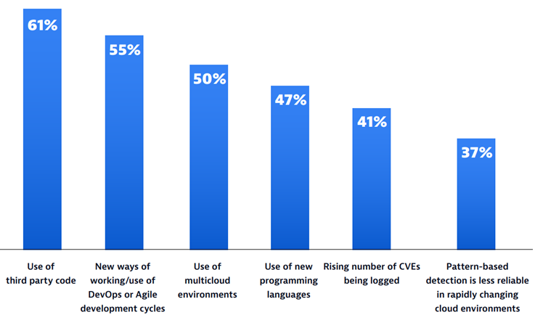
Scary Slide No.2
Sec
Sec
Sec
Ops
Dev
Security Everywhere
68%
of apps had a security flaw that fell into the OWASP Top 10
Notes:
In a recent report from Dynatrace (Dynatrace Global CISO report 2023), CISOs were asked to identify factors that made it more difficult to pinpoint and resolve application vulnerabilities.
61% said that the use of 3rd part code caused issues. If we think about Log4J a number of organisations believed they where not exposed until they started to think about the dependencies not just of their only code, but the dependencies of the packages they use, and the exposure their vendors had.
I love the second value … 55% blamed DevOps and Agile. Two of the great innovations in the development world are causing our Cyber leads pain. Development is becoming too efficient and moving too quickly for security to keep up!
Finally, Veracode released some data … a scan of 130,000 applications found that nearly 68% of apps had a security flaw that fell into the OWASP Top 10. Hopefully we are all aware of OWASP (Open Web Application Security Project); the Open Source Foundation regularly revise and publish their top 10 vulnerabilities found in Web apps. The most recent (2021) has broken access control at number 1. Injection (including SQL Injection) is always in the top 10, this time at number 3. So what can we do to help our CISOs sleep better and our developers to avoid some basic mistakes?

Slide 9

Where should Sec live?
Sec
Sec
Sec
Ops
CI/CD
pipelines
Dev
Security Everywhere
Don’t break
every build
Trust, but
verify
Gold container
images
Infrastructure
as code
Challenge non-standard
architecture
Notes:
The most basic answer is CI/CD. Even the simplest pipelines can start you on the road to repeatable, reliable, and secure deployments. If you have to start with a documented set of manual steps, it is better than ad hoc “copy and pray” deployments. These steps can then be replaced over time with automated processes. Our goal is to automate everything, but that isn’t always possible. Code scans, syntax checking, dependency checks, and secret scans can all be introduced into pipelines to reduce the number of vulnerabilities and errors. We can trust that our developers won’t make mistakes, but there is no harm in verifying.
Similarly, replacing manual processes in application installation and configuration will provide predictable, reliable, secure, and faster deployments.
Everything as Code is a great concept and can bring great advantages, but remember code needs to be protected. You must provide the same controls for Infrastructure code as you do application code. Protected branches in version control, code reviews, and authorised pull requests should all be implemented.
A major trigger topic for me is how we use the cloud. There will always be a need for “lifting and shifting” on premise infrastructure into the cloud, but this should be the exception. The cloud provides cost and efficiency benefits through the use of cloud native resources and SaaS solutions. If we stick to our traditional VM-centric architecture, we will simply be creating another data centre and continue accruing technical debt. No matter where you own the VM, you will be responsible for the support and maintenance including patching.
Efforts should be made to work with architecture teams and support developers in their use of cloud native resource, and we should be willing to challenge the use of VMs.
The ambition to use containers is noble, but can inadvertently introduce vulnerabilities. An approved list of images should be created, and maintained, to allow developers to work quickly and efficiently.
Security has to be an enabler. If we come crashing in, imposing policies and constraints that slow down deployments or, worse, break previously working builds, the security culture will be ignored, processes will be circumvented, and tools to be turned off. Start small … introduce new controls and don’t immediately break everything. Then slowly turn the heat up until you reach your desired state.

Slide 10

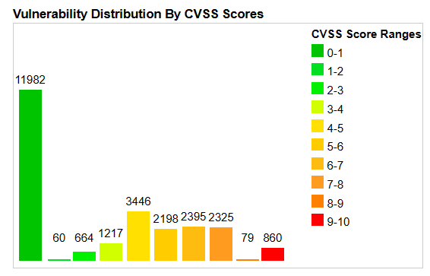
Scary Slide No.3
Sec
Sec
25,226
Sec
Ops
Common Vulnerabilities and Exposures (CVEs) were published last year alone.
Dev
Security Everywhere
57%
report that their breaches could have been prevented by installing an available patch
34%
victims knew of the vulnerability, but hadn’t taken action
Notes:
Now we’re in good shape, right? We have a strong secure development culture. We have reliable, repeatable, and secure deployments. What’s left?
25,226 Common Vulnerabilities and Exposures (CVEs) were published last year alone; and increase of 25% from 2021. Almost 70 per day! This year already there are almost 2,000.
Of those 26,000 CVEs 3.4% (860) had a CVSS score between 9 and 10, the most critical.
A report on the State of Application Security (Forrester) tells us that 57% of cyberattack victims report that their breaches could have been prevented by installing an available patch. Even more chilling, 34% of those victims knew of the vulnerability, but hadn’t taken action
74% of companies say they simply can’t patch fast enough because the average time to patch is 102 days according to Ponemon.

Slide 11

Where should Sec live?
Sec
Sec
Sec
Ops
Destroy &
rebuild
Dev
Security Everywhere
Policy
compliance
Continuous
monitoring
Proactive
patching
Vulnerability
Management
Posture management
reporting
Notes:
One of my favourite concepts when talking about cloud is the ability to destroy and rebuild resources and the idea of pets versus cattle. I remember the last time I asked for a new, on premise, server. After much form-filling, interrogation, and small brown envelopes in the hands of the right people, I finally got my server. It was like a pet. When it was ill I’d care for it by updating and patching software. I’d feed it with new applications and libraries. And, I’d never let it be turned off. But in the cloud we have to think very differently. Our resources shouldn’t be treated as pets; they should be seen as cattle. When a head of cattle is ill, it is disposed of, and replaced. This should be the same with our cloud assets.
Embracing this concepts helps us in a number of ways. Setting up processes to destroy and recreate assets with the latest versions of software keeps us on top of any newly released vulnerabilities. If we regularly rejuvenate our assets every 7 days, we limit the potential persistence of any issues. A hacker can spend weeks trying to infiltrate a system and systems that get refreshed regularly are going to a more difficult target.
Patching, vulnerability management, and Cloud Security Posture Management are big topics, and I have a completely separate rant about them…. See me after class if you are interested.
As part of our vulnerability management, threat intelligence and insights into our cloud assets will help us understand what is a real risk and which are truly critical severity vulnerabilities for us. Having a list of issues for an individual asset gives us limited information, what we really need is context. If you remember one thing from this presentation about monitoring it should be this … Risks without context are meaningless.
A major part of everything I’ve talked about so far is culture, and one of the most important elements of this is communication. Any operational team, whether it be application support or security, need to be in constant contact with developers. No longer can we raise a backlog item and forget about it, we need to collaborate to enforce positive behaviors.
Needless to say they are all important and creating the people, processes, and tooling is vital. Knowing what you have in the cloud can be challenging due to the ephemeral nature of cloud resources, but understanding what your estate looks like is imperative. You can’t protect what you don’t know about.

Slide 12






#DevSecOpsHow
Culture
Infrastructure
Secure code training
Peer reviews
Unit testing
Coding champion
Threat modelling
Coding standards
First warning … stop reading!
Image library source
Server hardening
Patching
Gold image curation
Networks and firewalls
Automatic provisioning
Developer Tooling
Monitoring
DevSecOps
IDE
Package Management
Application Lifecycle Management
Ticketing system
DAST tooling
Source control
Logging
Metrics
Analysis
Reporting
Threat intelligence
Evidence as policy
Slide isn’t meant to be read
Process Chain
(abridged!)
Deployment
Operations
Build pipelines
SAST tooling
Automated testing
Deployment environments
Automatic fault reporting
DAST tooling
Secrets management
Stop reading this slide!
Support
Service desk
Continuous monitoring
Vulnerability management
Security scanning
Policy enforcement
Notes:
I’ve given you an overview of how to start, or continue your DevSecOps adventure … I don’t like the word journey, but I appreciate it can be overwhelming.
This slide, and the next, are “anti-best practice” slides – they are not meant to be read, and I’ve already excepted my on personal limit for slides per presentation. But it is important to understand the scale of what we are trying to achieve and how much there is to do.
We talk about the giants of DevSecOps … Netflix, Microsoft, Google, CapitalOne. These companies seem to have it all sorted, performing hundreds of deployments a day. We can learn a lot from them, but there is one thing that is more important to learn than anything else. It took these companies 10 years to get where they are today.
So … Identify an area for improved within your own organisation … implement a change … check it’s effectiveness … keep if it is positive … dump if it isn’t … repeat.

Slide 13
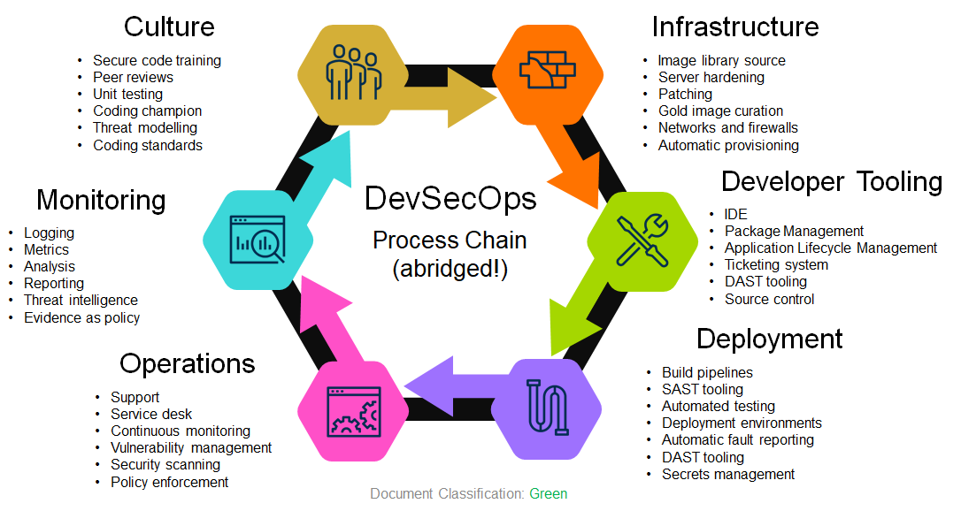
#DevSecOpsHow
The DevSecOps
Toolchain
Infrastructure
Culture
Azure Virtual Machines
Amazon Machine Images
GCP Compute Engine
Docker
ECR
Terraform
YAML
Ansible
Chef
SaltStack
AWS CloudFormation
Azure Resource Manager
CIS Benchmarks
SCCM
Qualys Patch Management
Automatic Updates
Code Warrior
Pluralsight
OWASP Top 10
LinkedIn Learning
Udemy
Evil user stories
CERT Secure Coding Standards
Game day exercises
Gerrit
Github pull requests
Review board
JUnit
xUnit
Evil user stories
OWASP Threat Dragon
CERT Secure Coding Standards
Monitoring
Developer Tooling
Azure Defender for Cloud
Azure Sentinel
Splunk
SolarWinds
RSA NetWitness
Archer
ThreatConnect
OWASP Threat Dragon
Chef
HashiCorp Sentinel
nmap
Etsy Morgue
Orca Security
HackerOne
graphite
Wiz.io
NPM
NodeJS
SonarLint
DeepSource
SonarQube
JetBrains
Github
GitLab
BitBucket
Azure DevOps
Github Actions
JIRA
Artifactory
ReSharper
Final warning! Stop it!
VSCode
Operations
Deployment
BMC Remedy
ServiceNow
LinkedIn Learning
Udemy
Evil user stories
OWASP Threat Dragon
CERT Secure Coding Standards
Qualys
Tenable
Spiceworks
BeyondTrust
AWS CloudTrail
Nessus
Seriously … stop reading! You will hurt your eyes.
Jenkins
Azure DevOps
AWS Deploy
VeraCode
Fortify
Selenium
TestComplete
Azure Key Vault
AWS KMS
Atlassian Bamboo
TeamCity
YAML
PowerShell
SARIF SAST Tools
Yarn
Test Management
(VERY abridged!)
Notes:
If you thought the previous slide was overwhelming, then I apologise for this.
There are a lot of vendors and an even greater number of tools that will “do” DevSecOps for you. Just like culture; Start small and build.
Budgets are always a factor, so start with open source tools … remembering to keep them up to date! Prove their worth by creating and tracking metrics that can be communicated across your organisation and show managers the improvements.

Slide 14





Vince’s Five Rules of DevSecOps in the Cloud
3
Set policies and controls and enforce them through automation
1
Use the benefits cloud platforms gives you
2
Automate everything; where you can’t automate, secure the manual process
4
Report on compliance and make the data available to all teams
5
Tooling cannot fix all your problems, invest in people and processes
Notes:
Too often due to time pressures or the lack of capacity or capability, we lift and shift rather than use the enhanced features and resources that cloud platforms afford us. The more you build the more you have to work. A lot more maintenance is needed for a website that is built on a cloud VM than if using a native application (WebApp). The cloud is more than just another data centre to support and maintain. If you don’t use the benefits of the Cloud, you will be creating technical debt that will, in all likelihood, outlive your role. Capitalise on data storage resources instead of a database server. Use bastion resources instead of creating yet another VM as a jumpbox.
Code reviews, unit testing, integration testing, continuous monitoring, all these CAN be automated by investing in tooling … there are many companies here today that will gladly help you. We can aim to automate everything, but we have to be realistic. Not everything can, or will be automated. For those manual processes that remain, spend time reviewing the process and make it as secure as you can. Too often I build processes that are so complex that only a few people understand them (which opens a bigger can of worms), or deployment pipelines that stop in the middle to allow some manual manipulation.
Policies and controls are the guardrails that protect us from ourselves. Use the to create a safe area for developers to work in. Trust but verify.
Having compliance statistics available isn’t the end of the story. Use this data to praise the good, and highlight the bad.
Please, go out and support the companies here today, but no amount of budget spending on the newest, shiniest tools will fix all your problems. Remember that companies grow great through a combination of People, Process, and Technology. Create a culture of support, openness, and learning to retain the best staff. Define processes to enable work to flow and establish clear lines of feedback to help improvement. And, yes, invest in tooling. Tooling will support your processes, and help your staff be more efficient.

Slide 15

Questions?
Vincent King
Head of DevSecOps for Cloud Transformation
DevSecOpsVince.com

Slide 16





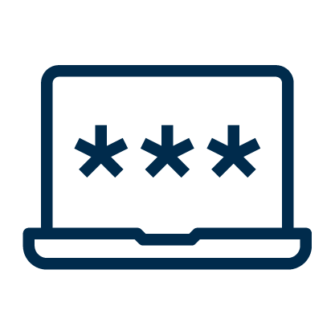



Notes:
Hot on the heels of Okta's source code breach, in December we had Slack experiencing a threat actor accessing their repositories using stolen (valid) tokens. Access tokens are an invaluable capability of working with remote services, including GitHub, but as always WE have to be careful as they can expose great power. Simple GitHub access token advice: - store tokens securely (always the first bit of advice in this type of post... don't write them down!) - use fine grained access tokens to enforce the principal of least privilege - create and enforce an expiration policy; the longer they exist, the more damage can be done - tokens don't just give access to code, they can allow access to Actions, so check their capabilities - and finally, understand why the token is needed; not every user or app needs access to repos.

Slide 17
Title
Dev
Dev
Sec
Ops
Notes:
Hot on the heels of Okta's source code breach, in December we had Slack experiencing a threat actor accessing their repositories using stolen (valid) tokens. Access tokens are an invaluable capability of working with remote services, including GitHub, but as always WE have to be careful as they can expose great power. Simple GitHub access token advice: - store tokens securely (always the first bit of advice in this type of post... don't write them down!) - use fine grained access tokens to enforce the principal of least privilege - create and enforce an expiration policy; the longer they exist, the more damage can be done - tokens don't just give access to code, they can allow access to Actions, so check their capabilities - and finally, understand why the token is needed; not every user or app needs access to repos.

